Slide 1


TOEX PROGRAMME PRESENTATION
Amanprit Dhaliwal

Slide 2

Format of the presentation
A. Crime outcomes in England and Wales from 2012 to 2022
C. Crime predictions
C. Recommendation
B. How has crime changed?

Slide 3
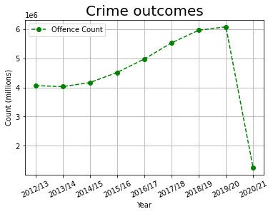
Crime outcomes

Slide 4
Crime outcomes
2,015,930

Slide 5

Period 2020/21
COVID-19
Online abuse of those with disabilities increased by more than 50% during 2020-21 (Sky News, 2021)
225% increase in online hate speech incidents in the UK last year. (Guardian, 2021)

Slide 6
Comparison
2012/13
2019/2021

Slide 7
Comparison (negative)
2012/13
2019/2021

Slide 8
Comparison (positive)
2012/13
2019/2021

Slide 9
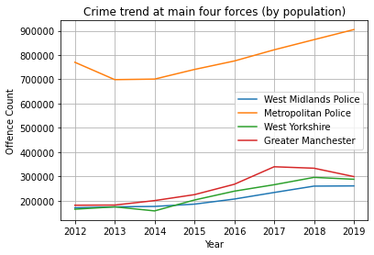
Comparison between four main forces in England and Wales
Greater London
West Midlands
Greater Manchester
West Yorkshire

Slide 10
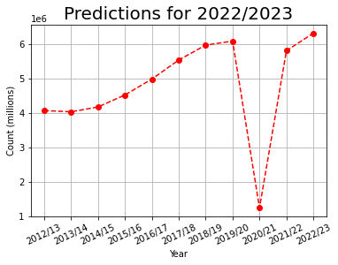
Future predictions
Cost of living
England going into recession
Staff shortage
Increasing number of cyber security attacks
Lack of technology infrastructures and facilities
Overall, 5.3 million offences (excluding fraud and computer misuse offences) were recorded by the police in the year ending March 2022 (GOV UK, 2022)

Slide 11
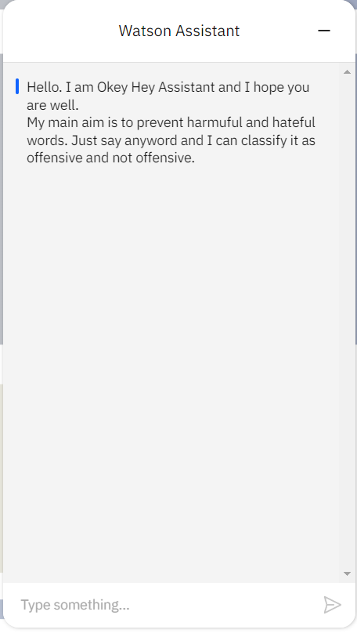
Recommendation
Staff training
Recruiting staff
Awareness and education
Prevention (e.g., crime detection platforms, crime prediction systems)

Slide 12

Thank you for listening to my presentation
By Amanprit Dhaliwal

Slide 13
List of references and project link
PROJECT LINK:
GitHub Link: https://github.com/amanpritaston/TOEX
Okeyhey chatbot link: https://web-chat.global.assistant.watson.appdomain.cloud/preview.html?region=eu-gb&integrationID=e8671dd8-f135-49f6-a376-f07f3e56e4e9&serviceInstanceID=9f5a03c9-f120-406a-9be0-b1823c5a0d15
RESEARCH LINK:
GOV.UK (2022). Available at: https://www.gov.uk/government/statistics/crime-outcomes-in-england-and-wales-2021-to-2022/crime-outcomes-in-england-and-wales-2021-to-2022
Sky. (2021). Available at: https://news.sky.com/story/online-abuse-of-those-with-disabilities-increases-more-than-50-percent-during-lockdown-12426989#:~:text=News%20%7C%20Sky%20News-,Online%20abuse%20of%20those%20with%20disabilities%20increases%20more%20than%2050,to%20police%20in%202020%2D21
The Guardian. (2021). ‘Nastier than ever’: have Covid lockdowns helped fuel online hate?’. The Guardian. Available at: https://www.theguardian.com/uk-news/2021/oct/19/nastier-than-ever-covid-lockdowns-rise-online-hate

